Slide 1
Guided Discussion Series
Election Functionality
Elections are NOT working well! Four problems need to be fixed.
Guide: Roy Minet

Slide 2
Four Important Election Fixes
(in order of increasing importance)
Stop taxpayer funding of any/all private political organizations.
Remove “artificial” ballot access restrictions to allow more choice and bona fide competition.
Eliminate gerrymandering.
Replace Plurality with a very much better voting method called AADV (covered in a separate session).

Slide 3
PBAC’s Reasonable Proposal
The Pennsylvania Ballot Access Coalition (PBAC) is advocating a very reasonable proposal called Political Party Equality or PPE that would simplify ballot access rules and make them fair (impartial). It has three provisions.
(PBAC is looking for a state senator and a state representative to sponsor a PPE bill.)

Slide 4
First PBAC PPE Provision
Eliminate taxpayer funding of private political organizations. All political parties would choose their own candidates according to their own party rules and at their own expense. The candidates so chosen would automatically appear on the November ballot.
Note: In addition, taxpayer subsidization of D and R (or any) national conventions also must stop. (This is not part of the PBAC PPE proposal)

Slide 5
Second PBAC PPE Provision
Equalize the definition of a political party. Consolidate all types of political bodies currently defined in the Pennsylvania Election Code into a single category: "Qualified Political Party." In order to be considered a Qualified Political Party, two criteria would need to be met:
One twentieth of one percent (0.05%) of statewide registered voters must be registered to vote as a member of that party. Given current registrations, the list of Qualified Political Parties in Pennsylvania under the proposed PPE act would only include the Democrat, Republican, Libertarian, and Green Parties.
Current party rules must be on file with the PA Department of State.

Slide 6
Third PBAC PPE Provision
Simplify ballot access for independents. Independent candidates (not affiliated with a Qualified Political Party) would need to collect the number of signatures as currently outlined by law in 25 CS 2872.1 rather than using the current complex formula. The window for collecting those signatures would not change, and all signatures would be validated by the county or state agency that receives them, not by private organizations or individuals (no other “challenges”).
Note: 25 CS 2872.1 defines the signatures currently required to get on the ballot for primary elections

Slide 7
Gerrymandering
Gerrymandering is the process of intentionally drawing electoral district boundaries in such a way as to create an advantage for a specific political faction.
In spite of sustained attempts to eliminate it (with near-unanimous public support), the practice is still very much alive and well.
There are examples of gerrymanders to benefit Democrats, Republicans and even “cooperative” gerrymandering that favors incumbents.

Slide 8
Packing and Cracking
Pack your opponent’s voters into as few districts as possible (where they will be in the overwhelming majority).
Spread the remaining opponents as evenly as possible in the remaining districts so that they are in the minority.
The idea is to have your favored faction in the majority in as many districts as possible.
This maximizes opponent’s “wasted votes” and minimizes the favored faction’s “wasted votes.”

Slide 9
Why Gerrymandering Is Alive and Well
Despite what they may say, politicians do not want to relinquish this power! They are superb at pretending that they want to abolish gerrymandering, but making sure it never happens! (This is effectively the show stopper.)
Persistent bad idea: Have an unbiased “citizens’ commission” draw political districts.
Persistent worse misconception: “Communities of Interest” (COI) must be “kept together.”
Incorrectly stated objective: Electoral districts must be “fairly” drawn.

Slide 10
Citizens’ Commission Problems
No one intelligent enough to draw districts is completely unbiased.
Selection of members is problematic.
Protection from “influence” is impossible.
Little to no transparency or public understanding.
Why make a group of new people reinvent the “redistricting wheel” every 10 years?

Slide 11
Keeping COIs Together Is Gerrymandering!
Who’s definition of COI would be used???
The only reason to keep COIs together would be so they can elect a representative who “truly represents their interests.”
In order to do that, the COI faction must have a majority so they can outvote the minority of any other faction(s).
But that is precisely the definition of gerrymandering!
COIs are presumed to coincide with political boundaries from which arises the notion that political entities should not be split.

Slide 12
Correctly Stated Objective
Electoral districts must be impartially drawn (not confer any systematic advantage to any faction).
Voter registration, voting history, racial/ethnic population cannot ever be considered.
Only population and geographic or political boundaries can be considered.
Instead of re-inventing the wheel every 10 years, why not write down a guaranteed-to-be-impartial procedure for drawing districts that could be followed either by people or by a computer?

Slide 13
The Precinct-Preserving Splitline
(PPS) Procedure
PPS can impartially draw any number of compact equal-population districts inside any closed geographical boundary (i.e. any state).
Only population and geographic/political boundary data are used.
PPS might divide any or all political entities, but will never divide the smallest, which are voting precincts (would be very disruptive to counties).
PPS can be followed by people, but why not use a computer and have redistricting done half an hour after new population numbers are available?

Slide 14
Suppose PA had two congressional districts. How would you draw them?
How about three districts?
How about four?

Slide 15
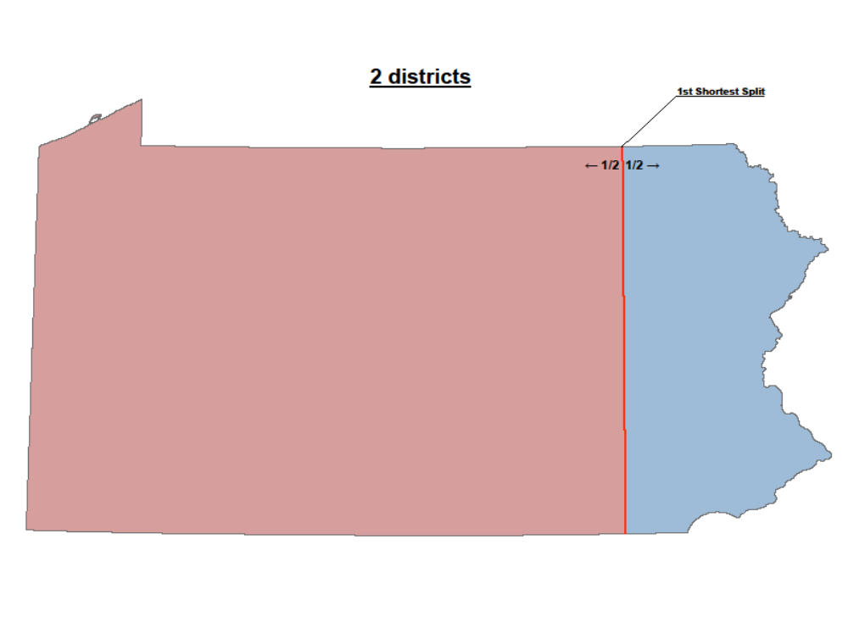

Slide 16
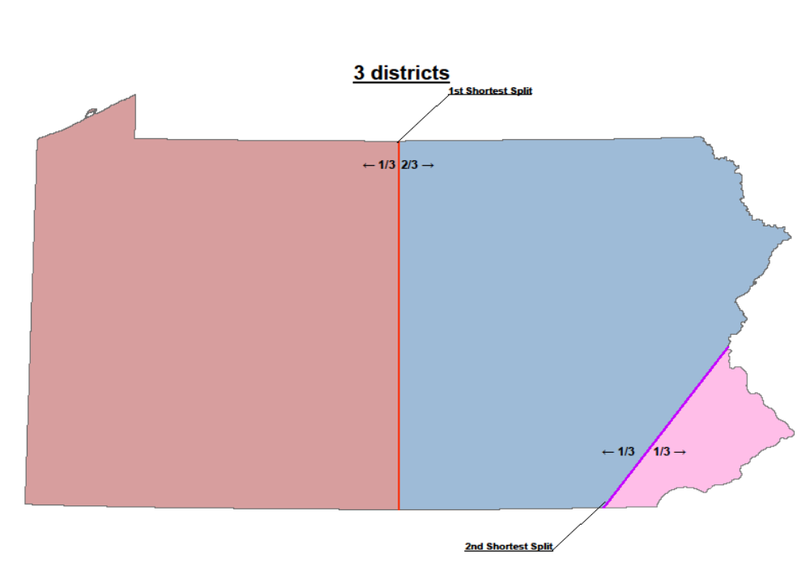

Slide 17
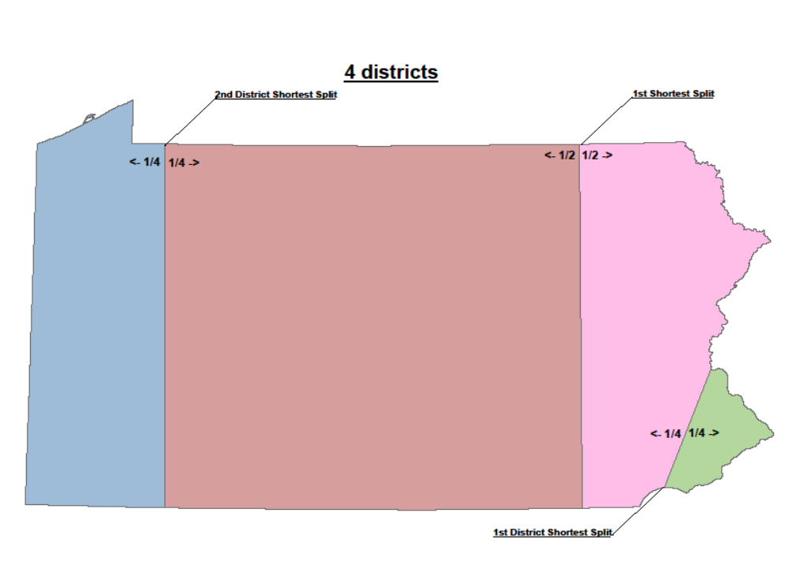

Slide 18
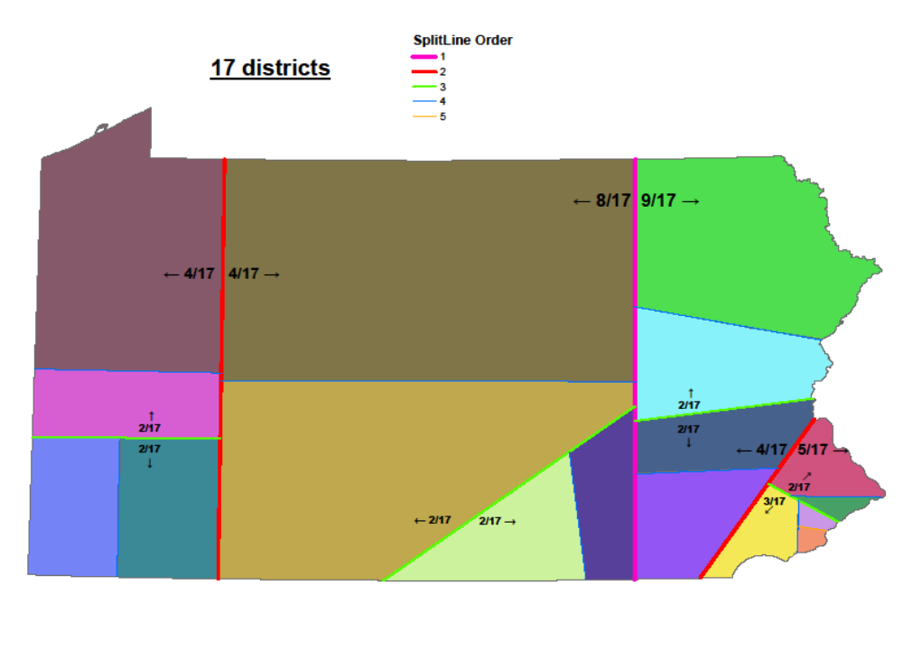

Slide 19
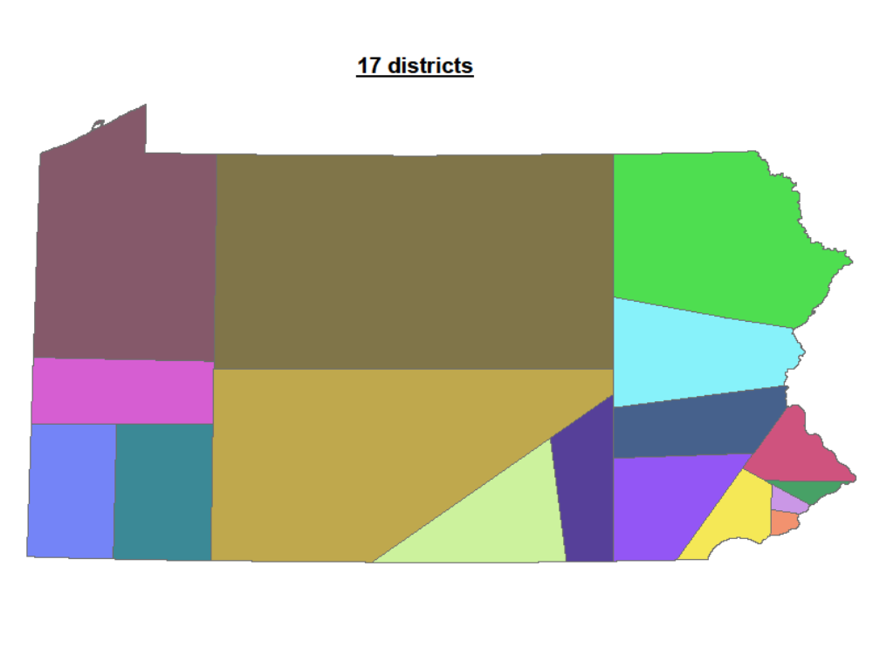

Slide 20
The Actual PPS Procedure
In all cases where a political entity (e.g., a state) is entitled to elect multiple representatives, the procedure defined here must be used to determine the electoral districts for such representatives. Voting precincts will never be divided. The geographic boundaries of political entities (States, Counties, Municipalities and Precincts) and the total populations for each precinct are the only data to be utilized.
If the population of the political entity is p and the number of districts to be drawn is n, the following (sometimes iterative) procedure is to be used.
1. If n is 1, no subdivision is necessary and this is a final district. If n > 1, then define two new numbers i = n/2 rounded up and j = n/2 rounded down. (Note that i + j always equals n, and if n is even, i obviously will equal j.)
2. Draw the shortest possible (great circle) line dividing the area into two sections so that one section has a population equal to p multiplied by i/n, while the population of the other section has a population equal to p multiplied by j/n. If there is more than one equally short line, use the line closest to a north-south orientation and if there is still a tie, use the westernmost line. For irregularly shaped entities, it is possible that a line could exit and then re-enter the entity; the length of the line is defined to be the total distance between the two most distant points of intersection which lie on the boundary of the area being subdivided.
3. Make a list of just the voting precincts which have parts of their area on both sides of the great circle line. If 80% or more of any precinct’s area lies on one side of the line, assign the precinct to that same side of the line. Sort the remaining list in the order of the largest population precinct to the smallest population precinct.
4. If there are any precincts on the list, assign the first (largest) to the side of the line which needs the most people to hit its population target. Repeat this step until all precincts have been assigned.
5. The division of the original large area into two sections has now been completely defined. For each of the resulting two sections separately, go back to step 1 using the section’s population for p and either i or j (whichever was associated with the section) as n.

Slide 21
PPS Advantages
Guarantees impartiality
Draws compact districts (any number for any state)
Completely eliminates politicians’ influence
Anyone can verify that districts are correctly drawn
Can be done by people or computers
Some “term limiting” as a byproduct
Turns redistricting into a quick, low-cost non-event
The PPS procedure could be amended into any state constitution or the U.S. Constitution

Slide 22
Credits
The map-work was generously contributed by Stephen Kruzik (who doesn’t like public credit, but isn’t here, so he is gets credit).
Warren D. Smith invented the basic splitline procedure circa 2002.
Roy Minet independently invented the same basic procedure, but with the precinct-preserving feature circa 2009.

