Slide 1
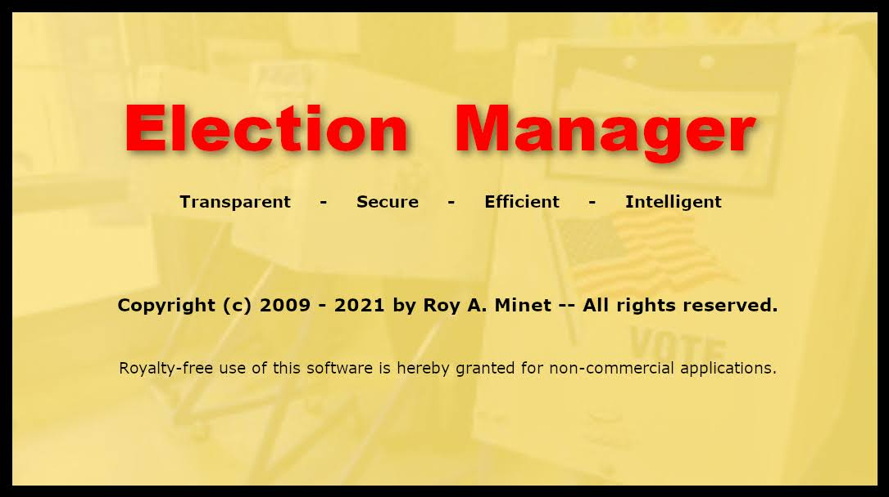

Slide 2
What Is Election Manager?
Election Manager is client/server software which supports all aspects of elections and will run on substantially any hardware and operating system combination.
Clients communicate with the server using only the HTTP “Post” command.
“Client 0” has special functions and privileges and is the control client.
The Plurality and AADV voting methods are supported.

Slide 3
Election Manager Modes
Jurisdiction Setup: Supports defining jurisdictions anywhere on Earth (country, states, counties, municipalities, precincts, districts)
Election Setup: Supports setting up any number of elections with political parties, races, candidates, aliases (Elections can be exported and imported)
Voting: Controls/supervises voting at a precinct (any number of voting booths) on election day
Tally: Tallies/reports the votes for any number of precincts for an entire election

Slide 4
During Voting
Each voter checks in, is positively identified and assigned to a voting booth
Voters complete their ballots via touch-screen
EM prints a simple, clean, voter-verifiable paper ballot
Voters verify their ballots before depositing them into the ballot box on their way out

Slide 5
Upon Closing of the Polling Place
EM creates a text file of the ballots and their choices in random order for each precinct
The ballot files are posted publicly on the Internet
EM (run by anybody anywhere) tallies the results using the ballot files from all precincts (any other tally method could also be used)
Each polling place verifies its ballot file either by verifying that totals match the ballots OR by matching up the ballots from the ballot box one-to-one to the listing of them in the text file OR both

Slide 6
The Crucial Precinct Ballot Files Are:
Both human and machine readable (XML)
Triple-redundant (3 complete ballot listings in three different sort orders)
Quadruple-tamper-evident
Can be checked and tallied by anybody anywhere
There is no way to identify the voter who cast any particular ballot
There is no way that a voter can prove to someone else how s/he voted

Slide 7
Election Manager Advantages
Airtight integrity – Complete ballot secrecy with hard copy audit trail and all machine outputs are verified as regular procedure; detailed logging of all significant events
Transparency – No proprietary hardware or software and all precinct results are public
Efficiency – Easy for voters, no spoiled ballots and complete final results (including write-ins) are available half an hour after polls close
Can use either plurality or AADV (Approve/Approve/Disapprove Voting)!

