Slide 1
Guided Discussion Series
The Six Pillars of a Free Market Economy
Some important characteristics of a free market economy.
Guide: Roy Minet

Slide 2
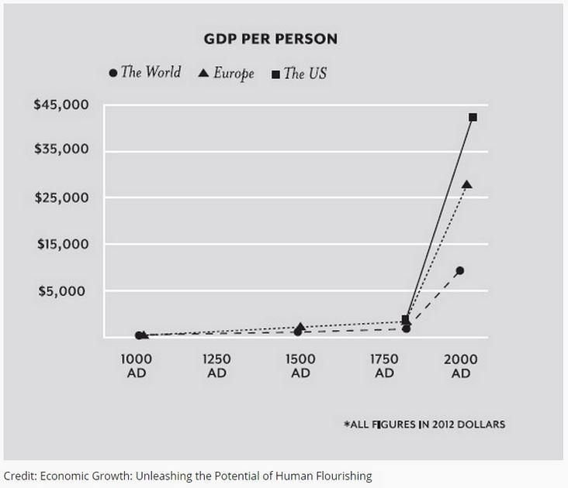

Slide 3
Billions Lifted Out of Poverty
A 2017 study by the World Bank revealed that an increasing shift to (predominantly) free market economies has lifted billions of people out of grinding poverty. The percentage of the world population living on $1.90 per day per person (in 2017 dollars) has improved as shown below:
1820 – 84%
1981 – 42%
2017 – 8%

Slide 4
Who Invented
The Free Market Economic System?

Slide 5
Who Invented
The Free Market Economic System?
Nobody invented the Free Market Economic System.
A free market economic system will automagically self-organize when people are
Free
Honest
Peaceful
It is an entirely natural phenomenon.

Slide 6
What Took So Long?

Slide 7
What Took So Long?
Previously, no sizeable community of people was sufficiently free.
In 1690, John Locke promoted the idea that people should have rights: life, liberty, property
Other thinkers picked up and amplified the rights idea, leading to the “Age of Enlightenment.”
People gained more freedom during the 1700s and that was especially so in the New World. That is why free markets then formed and prospered.

Slide 8
What Is an “Economic System”?

Slide 9
What Is an “Economic System”?
An economic system provides the answers to the three economic questions:
What goods and services are to be produced?
For whom shall they be produced?
How shall they be produced?
How these three economic questions are answered determines the type of economic system.

Slide 10
How Many Different Types of Economic System Are There?

Slide 11
How Many Different Types of Economic System Are There?
There are only two distinctly different types of economic system.
Free Market Economy – People are left free to answer the three economic questions themselves. All resources are allocated/managed in a completely voluntary and decentralized way by cooperating individuals and groups.

Slide 12
How Many Different Types of Economic System Are There?
There are only two distinctly different types of economic system.
Free Market Economy – People are left free to answer the three economic questions themselves. All resources are allocated/managed in a completely voluntary and decentralized way by cooperating individuals and groups.
Command Economy – A central power or authority answers the three questions. Resource allocation is centrally planned and controlled.

Slide 13
There Are No Pure Economic Systems
Command Economy – There are no pure command economies – they would collapse in 10 minutes (from poor resource allocation).

Slide 14
There Are No Pure Economic Systems
Command Economy – There are no pure command economies – they would collapse in 10 minutes (from poor resource allocation).
Free Market Economy – There are no pure free market economies – the government would meddle and screw it up in 10 minutes.

Slide 15
There Are No Pure Economic Systems
Command Economy – There are no pure command economies – they would collapse in 10 minutes (from poor resource allocation).
Free Market Economy – There are no pure free market economies – the government would meddle and screw it up in 10 minutes.
Mixed Economy – All actual economies are mixed economies with some degree of freedom and some central control (meddling).

Slide 16
But How About Capitalism?
Capitalism = Free Market Economic System
The name “capitalism” was coined and used by Karl Marx in Das Kapital. Marx was a huge enemy of the free market and was able to stick it with an evil-sounding name.
Please do not use the term “Capitalism”
Always say “Free Market Economy”
“Crony Capitalism” does sound sort of evil. But “Crony Free Market Economy” sounds like the oxymoron it is. (The proper term is “crony statism.”)

Slide 17
Free Market Economy Characteristics
Functioning is completely voluntary; no force is ever required.
Therefore, it is the only economic system consistent with the NAP (non-aggression principle).
Counterintuitively, it is the most powerful engine of economic growth possible, which results in the most rapid creation of wealth that is possible.
Peaceful, honest people left on their own will spontaneously self-organize into a free market economy.

Slide 18
The Role of Government
Secure and guarantee people’s rights – make sure they are:
  Free
  Honest
  Peaceful
Refrain from screwing up the free market economic system that automatically develops and flourishes.

Slide 19
The Six Pillars
Of a Free Market Economy
Private Property – A well-secured right to private property ownership is the first pillar. Without it, there can be only chaos.

Slide 20
The Six Pillars
Of a Free Market Economy
Private Property
Specialization – People must be free to specialize in whatever they do best. This allows further honing of skills and the development of tools, thus greatly improving productivity.

Slide 21
The Six Pillars
Of a Free Market Economy
Private Property
Specialization
Voluntary Exchange – People must be free to voluntarily exchange goods and services. Both parties to a voluntary exchange must benefit (otherwise the exchange would not take place). Thus, every such exchange actually increases total wealth. This is only guaranteed when the exchange is completely voluntary on both sides. It is some of the most powerful “magic” of a free market economy. (A barter economy so far.)

Slide 22


Slide 23
The Six Pillars
Of a Free Market Economy
Private Property
Specialization
Voluntary Exchange
Price System of Resource Allocation – Sound money is required. Prices must be free to adjust to the “market clearing price.” This is a point of equilibrium where the quantity produced equals the quantity consumed. It is the current “market value” of each commodity in the economy. Prices are critical signals which must not be corrupted as prices optimize resource allocation to produce the most wealth.

Slide 24
The Six Pillars
Of a Free Market Economy
Private Property
Specialization
Voluntary Exchange
Price System of Resource Allocation
Market Competition – Free and open competition among multiple buyers and multiple sellers in many transactions provides the “pressure” which causes prices to always seek the market-clearing price.

Slide 25
The Six Pillars
Of a Free Market Economy
Private Property
Specialization
Voluntary Exchange
Price System of Resource Allocation
Market Competition
Entrepreneurship – People who are willing to assume the risk of investing to organize land, labor and capital (the three factors of production) to produce goods or services.

Slide 26
Some “Big Picture” Considerations
Commodity Substitutes
The nature of a business
That Which Is Seen and That Which Is Not Seen
Wealth Distribution
The “Safety Net”

Slide 27
Commodity Substitutes Result In
Colossal Complexity!
Virtually every commodity has substitutes.
This causes everything to interact with everything else.
Changes in one sector of the economy cause changes in other sectors and vice versa.
Microeconomics – Teaches the basic laws of economics about which everyone agrees.
Macroeconomics – Attempts to understand entire complex economies, which is extremely difficult and error prone; lots of disagreement!

Slide 28
When the Price of Gasoline Increases
Less gasoline will be purchased because:
More efficient planning of trips
Eliminate least important trips
Increased carpooling
Ethanol and propane (direct substitutes)
Use plane, train, bus, taxi, or Uber
Buy/ride a bicycle or walk
Switch to hybrid or electric vehicles

Slide 29
The Nature of a Business
A business is an organization set up to marshal material, labor, and equipment to provide goods or services and to measure/track how effectively these resources are used. There are always three sets of people associated with a business:
Customers (voluntarily exchange money for goods or services)
Employees (voluntarily exchange work for pay)
Owners or shareholders for a corporation (win or lose based on profits)

Slide 30
Profits Are Always Good
For Everybody!
The total operating costs of a business measure the amount of wealth it consumes.
The total sales of a business measure the amount of wealth it creates or produces.
Therefore, the profit (sales – costs) is the additional wealth the business has contributed to the economy.
A business which is losing money consumes more wealth than it produces. That is why it is critically important that it either improve quickly or cease to exist. The remaining assets can then be reallocated to other uses which increase (rather than decrease) everyone’s standard of living. Never subsidize!!

Slide 31
No Business Can Pay Taxes
Only people can pay taxes. Any taxes collected from a business must come from its:
Customers (higher prices)
Employees (lower wages or benefits)
Owners (lower profits)
Or (usually) some combination of all three
Taxing businesses is just a way to hide the taxes from the people who actually pay them.

Slide 32
Average US Business Profit
Does anyone have any idea what the average bottom line profit is that a US business earns (as a percentage of its sales)?

Slide 33
Average US Business Profit
Does anyone have any idea what the average bottom line profit is that a US business earns (as a percentage of its sales)?
It is 3.8%
If all businesses cut their prices to the point where they make zero profits, it would only be an average of 3.8% reduction of prices!
Source: Internal Revenue Service analyst for the year 2004. Total sales were $20 trillion.

Slide 34
That Which Is Seen and
That Which Is Not Seen
Suppose the government levies a tax on “the wealthy” to feed “the poor.”
The benefit to the poor is seen by the public as a good thing (the politicians make certain of that).
Not seen is the delayed negative effects from confiscation of taxes that are diffused throughout the economy.
The unseen bad effects more than offset the good, so total wealth is reduced.

Slide 35
French economist, Fredrich Bastiat, explained all this very lucidly in 1850 in two publications:
A book titled The Law -- https://fee.org/media/14951/thelaw.pdf
An essay titled That which Is Seen, and That Which Is Not Seen: -- http://bastiat.org/en/twisatwins.html
Both are simply written and very easy for anyone to understand.

Slide 36
Wealth Distribution
The free market system is often criticized for fostering an unequal distribution of wealth.
Unequal wealth distribution is absolutely necessary and required!
If wealth were somehow to be distributed equally, the 6th pillar (entrepreneurship) would be destroyed because entrepreneurs would no longer have any incentive to take risks.
BTW, there is no known economic system that can produce an equal distribution of wealth.

Slide 37
A free market economy produces a “normal” (approximately Gaussian) distribution of wealth:
  A small number of very poor.
  A large middle class which possesses most of the wealth.
  A small number of very wealthy.
A command economy produces a “two-spiked” wealth distribution:
  A very large number of very poor.
  Almost no middle class.
  A small number of extremely wealthy (those who hold the power and make the decisions).

Slide 38
A Question to Be Asked
Would we prefer to have equal wealth distribution or would we prefer to reduce poverty?
It is impossible to have both!

Slide 39
Appreciate and Thank Rich People
You cannot use force or fraud in a free market economy, so the only way to get rich is to do a very good job of enriching many others by satisfying their wants (offering them goods or services at a lower price than other suppliers).
Being wealthy is the evidence that you have done a great job of helping a lot of others and that you deserve many thanks.
Wealth accumulation enables private charity!

Slide 40
Free Market Characteristics Summary
There are billions and billions of negative feedback loops that optimize resource allocation.
Everything interacts with everything else to some degree. The complexity is huge and, as a whole, defies comprehensive understanding!
Left alone, wealth production is maximized.
Perturbing it with force will cause it to seek a new equilibrium, but wealth production will be lower. (Perturbation examples: subsidies, minimum wage laws, taxation, loan guarantees, “regulations,” etc.)
A perturbation always has an effect that is seen and other effects that are unseen which are in the opposite direction and larger than the visible effect. (Bastiat)

Slide 41
The End
Note: These slides are available on royminet.org
Also see the book: The Savior of the World – Comprehending the Free Market Economic System by Roy A. Minet

