Slide 1
Definition of a “Right”
Right – A liberty of action or a benefit to which an individual is entitled, that cannot be taken away (i.e., the individual is normally able to enjoy the right substantially all of the time).

Slide 2
Negative and Positive Rights
Negative (traditional) rights place no burden or claim upon the resources of others.
  Life
  Liberty
Positive rights require an expenditure of resources by others to provide or secure the right.
  Life (if defined to guarantee shelter, clothing and three square meals per day)
  Health care (beyond just what you could provide for yourself)

Slide 3
Rights Are Messy!
Even defining a traditional or “theoretical right” is messy – there are always gray areas.
A theoretical right has zero practical or actual value unless it is “secured” (i.e., almost everybody can actually enjoy the right almost all of the time).
Securing rights requires that a “sufficiently large” amount of force be available to suppress violations of rights a “very large” percentage of the time. (This is a dangerous entity.)
So, in a very real sense, it is the mechanism that secures rights that defines what rights actually are and who gets to benefit from them.

Slide 4
There Is No Such Thing
As “Natural Rights”
There is no “list of rights” that are automatically provided for humans by nature or by a deity.
Continuing efforts to justify natural rights have failed; it’s just muddled thinking!
Believing that there are (or should be) such rights just for us humans is the ultimate hubris.
Nature can be counted upon only for the consistent enforcement of the objective laws of physics and the impartial, relentless enforcement of survival of the fittest under these laws.

Slide 5
Clearing Away All The BS And Fog
The concept of a “right” or a set of “rights” is entirely an invention of the human intellect.
Therefore, rights do not “come from” anywhere.
It is completely up to humans to define what rights are or should be, and also to construct the mechanism needed to secure the rights.
As is well known, any mechanism powerful enough to secure rights is powerful enough to take them away – therefore, very dangerous!
Nevertheless, anarchy is not stable or efficient, and is not the best solution (although quite possibly it’s better than what we have today).

Slide 6
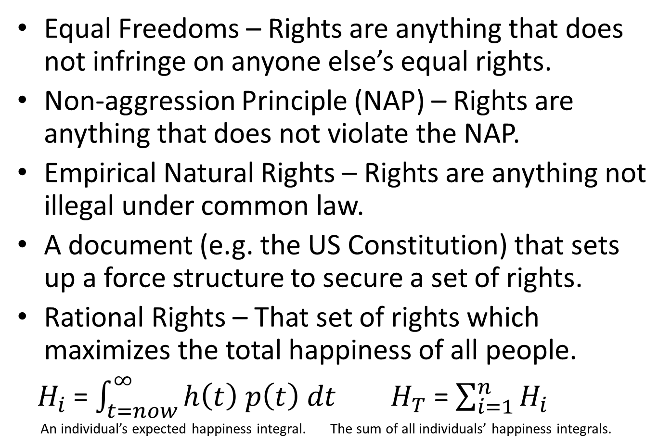
Five Ways to Define Rights
Equal Freedoms – Rights are anything that does not infringe on anyone else’s equal rights.
Non-aggression Principle (NAP) – Rights are anything that does not violate the NAP.
Empirical Natural Rights – Rights are anything not illegal under common law.
A document (e.g. the US Constitution) that sets up a force structure to secure a set of rights.
Rational Rights – That set of rights which maximizes the total happiness of all people.
${ H}_{i}$ = $\int_{t=now}^{∞}{h\left(t\right) p\left(t\right) dt}$ $H_{T}$ = $\sum_{i=1}^{n}{H_{i}}$
An individual’s expected happiness integral. The sum of all individuals’ happiness integrals.

Slide 7
The Non-Aggression Principle (NAP)
Nobody* may engage in fraud, and nobody* may initiate the use of force (or the credible threat of force) against anybody* else (or their justly-owned property) for any reason, excepting that minimum amount of force which may be necessary to enforce this non-aggression principle.
  * “Nobody” and “anybody” mean any societal entity; a societal entity might be an individual, organization, business, government, etc.
The NAP defines a voluntary society in which aggression is minimized for all who are peaceful and honest.
Note: Sometimes the NAP is shortened by neglecting to mention that some force will inevitably be required to enforce the NAP. This can lead to incorrect conclusions.

Slide 8
So, What To Do About Rights?
It is indeed encouraging that all approaches lead to a set of rights that include the Lockean “natural rights” of life, liberty and property!
We could do far, far worse than the Empirical Natural Rights that evolved with common law.
Rights derived from the NAP or Equal Freedoms do not “come with” any force structure to secure them.
Best Plan: Very carefully design and implement a force structure to secure a “good” set of rights; pay extra heavy attention to safeguards that will keep it under control this time!

